Slide 1

Management Systems for Educational Organizations based on ISO 21001:2018
ISO 21001

Slide 2



Slide 3






In House Team
Chaminda Karunanayake
-Director Business Development –
(MSc Herriot Watt, MBA-USQ, PhD candidate (Sri Jaya))
Sugath Hettiarachchi
-Director System implementation-
(DOSH, DQA, Lead Auditor EMS,QMS, OHMS, BSc-Colombo)
Madusha Sewwandi
-QA & Project Lead-
(HND-Food Science)
Isuru Denagamage
-Marketing & Brand Executive
(BSc (Hons) in Agriculture, PGdip Marketing (SLIM) )
Asheni Silva
-Compliance Specialist-
(LLB-UK, LLM-Candidate)
Pravinda Bhagya
-Consultant-
BSc, MSc, PhD(Candidate-Aus)

Slide 4















Our Experience

Slide 5

TOPICS TO COVER TODAY
Introduction to ISO 21001:2018 certification
Structure of ISO 21001:2018
Why EOMS?
Principles of EOMS
Benefits of EOMS

Slide 6

What is ISO 21001: 2018?
ISO 21001:2018 standard is the internationally recognized best practice framework for an Educational Organizations Management System (EOMS).
This standard acts as a common management tool for organizations providing educational products and services capable of meeting learners' and other beneficiaries' requirements.

Slide 7

WHAT IS ISO 21001:2018 CONT..
ISO 21001 EOM is based on ISO 9001 - Quality Management System, but it provides a specific framework for educational organizations that aim to enhance the satisfaction of their learners by improving the educational processes and ensuring conformity to learners’ requirements.
The standard can be applicable to all organizations that provide a curriculum for the development of knowledge, skills and attitudes by means of different lecturing methods.
ISO 21001:2018

Slide 8

Why EOMS ?
Education is a fundamental need for everyone in the society. Hence, it is essential to maintain good quality of education delivered by the educational organizations.
The ISO 21001 certification will enable you to provide educational services in a more effective and efficient manner.
By becoming ISO 21001 certified, you can demonstrate to the interested parties that you are committed towards improving your educational system to an international standard.

Slide 9
11. EOMS Principles
Focus on learners and other beneficiaries;*
Visionary leadership;*
Engagement of people;*
Process approach;*
Improvement;*
Evidence-based decisions;*
Relationship management;*
Social responsibility;
Accessibility and equity;
Ethical conduct in education;
Data security and protection.

Slide 10


Focus on learners and other beneficiaries
Sustained success is achieved when an educational organization can address the requirements of every learner, while at the same time attracting and retaining the confidence of other beneficiaries such as employers, parents and governments. Successful organizations work to ensure that every learner performs to their highest potential.
b) Visionary leadership;
Creation of unity of purpose and the direction and engagement of people enable an organization to align its strategies, policies, processes and resources to achieve its objectives. Involvement of learners and other beneficiaries in the leadership ensures a continuous focus on their needs, and avoids a disconnect between people engaged by the organization and those served by it.

Slide 11

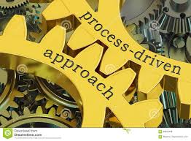
c) Engagement of people;
Creation of unity of purpose and the direction and engagement of people enable an organization to align its strategies, policies, processes and resources to achieve its objectives. Involvement of learners and other beneficiaries in the leadership ensures a continuous focus on their needs and avoids a disconnect between people engaged by the organization and those served by it.
d) Process Approach
The EOMS consists of interrelated processes. Understanding how results are produced by this system enables an organization to optimize the system and its performance.

Slide 12


e) Improvement;
Improvement is essential for an organization to maintain current levels of performance, to react to changes in its internal and external conditions and to create new opportunities.
f) Evidence-based decisions;
Decision-making can be a complex process and it always involves some uncertainty. It often involves multiple types and sources of inputs, as well as their interpretation, which can be subjective. It is important to understand cause and effect relationships and potential unintended consequences. Facts, evidence and data analysis lead to greater objectivity and confidence in decision making. Particularly, decisions on which facts to teach have lasting consequences on learners and society.

Slide 13

g) Relationship management;
Relevant interested parties influence the performance of an organization. Sustained success is more likely to be achieved when the organization manages relationships with all of its interested parties to optimize their impact on its performance. Relationship management with its provider and partner networks is of particular importance.

Slide 14


h) Social responsibility
Based on the definition of social responsibility in ISO 26000, an educational organization is responsible for the impacts of its decisions and activities on society, economy and the environment, through transparency and ethical behavior that:
— contributes to sustainable development, including quality education for all, health and safety, as well as the welfare of society;
— takes into account the expectation of interested parties;
— is in compliance with applicable law and consistent with international norms of behaviour;
— is integrated throughout the organization and practices in its relationship.

Slide 15

Accessibility and equity
Educational organizations need to ensure that the widest possible pool of people can have access to their educational products and services, subject to their constraints and resources. They also need to ensure that all learners can use and benefit from those products and services in an equitable manner.

Slide 16

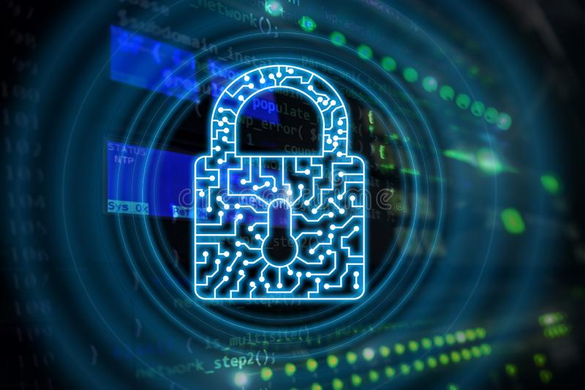
j) Ethical conduct in education;
For sustained success, organizations need to project an image of integrity (honesty and fairness) in dealing with all interested parties. Staff of the organization should hold themselves up to the highest standards of professionalism in all their dealings
k) Data security and protection.
Successful organizations will create confidence by ensuring confidentiality, integrity and availability of data by identifying threats and vulnerabilities of their activities, and setting controls to prevent and mitigate those threats and vulnerabilities.

Slide 17

Benefits of EOMS
Improve your education management system in parallel with world class education organizations
Enhance the reputation of your institution
Promote equal opportunities for students regardless of their religious background, ethnic or cultural origin, gender, ability/disability
Encourage diversity
Provide personalized training and effective response to all learners
Stimulate creativity and innovation

Slide 18
BENIFITS of EOMS CONT..
Make education more accessible (physical or online settings)
You will be embarked into a continual improvement process monitoring align with the vision and towards the interests of all stake holders
Waste reduction and cost saving
Effective response to special need (SET)
Aligned with other ISO standards and guide documentations
Increased efficiency and effectiveness
EOMS - DETAIL

Slide 19
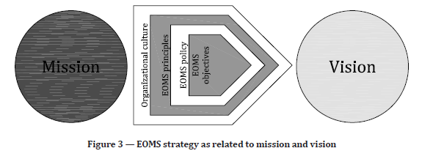
Better alignment of objectives and activities with policy (including mission and vision)

Slide 20
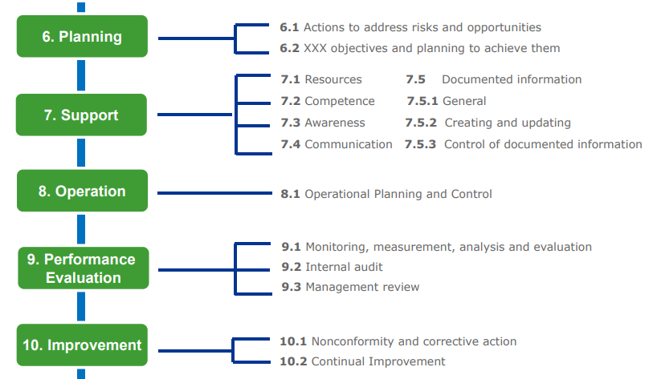


Slide 21
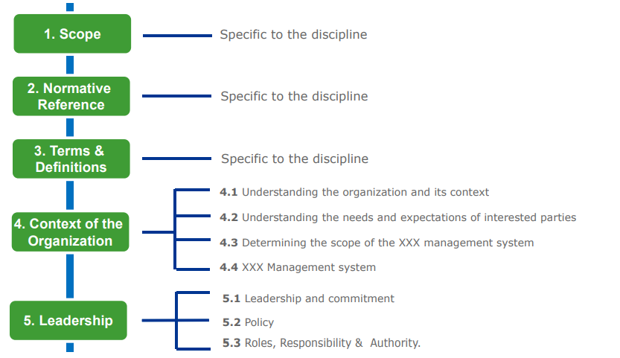

High Level Structure of ISO -X

Slide 22


Clause 4: Context of the organization
4.1 Understanding the Organization and its context
4.4 Management system for educational organizations (EOMS)
4. Context of the Organization
4.2
Understanding the needs and expectations of interested parties
4.3
Determining the scope of the management system for educational organizations

Slide 23
Clause 5: Leadership
5.1 Leadership & Commitment
5.2
Policy
5.3 Organizational Roles , Responsibilities & Authorities
5. Leadership

Slide 24

Clause 6. Planning
Planning
6.1 Actions to address risks & opportunities
6.2 Educational organization objectives and planning to achieve them
6.3 Planning of changes

Slide 25
Clause 7: Support
Support
7.1 resources
7.2 Competence
7.3 Awareness
7.4 communication
7.5 Documented Information

Slide 26
Clause 8 : Operation
Operation
8.1 Operational planning and control
8.2 Requirements for the educational products and services
8.3 Design and development of the educational products and services
8.4 Control of externally provided processes , products and services
8.5 Delivery of the educational products and services
8.6 Release of the educational products and services
8.7 Control of nonconforming outputs

Slide 27
Clause 9: Performance evaluation
Performance Evaluation
9.1 Monitoring, measurement, analysis and evaluation
9.2 Internal Audit
9.3 Management Review

Slide 28
Clause 10: Continual Improvement
10.2 Continual improvements
10.3
Opportunities for improvements
Continual Improvement
10.1 Nonconformity and corrective action

Slide 29
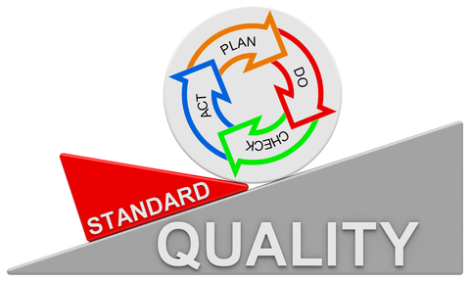
PDCA CYCLE
EOMS - PDCA

Slide 30

“Quality is never an accident; it is always the result of intelligent effort.”
– John Ruskin

Slide 31

References
ISO 9000:2015, Quality management systems — Fundamentals and vocabulary
ISO 9001, Quality management systems — Requirements
ISO 45001:2018 Occupational Health and Safety
ISO 10002, Quality management — Customer satisfaction — Guidelines for complaints handling in organizations
ISO 14001:2015, Environmental Management Systems
ISO 27001:2005, Environmental Management Systems

Slide 32


Slide 33





011 2576616 , 0777 169339, 071 600 4411
implemeters@isoconsultancy.lk, support@isoconsultancy.lk
No. 20, Kothalawala Avenue, Colombo 04.

